Slide 1
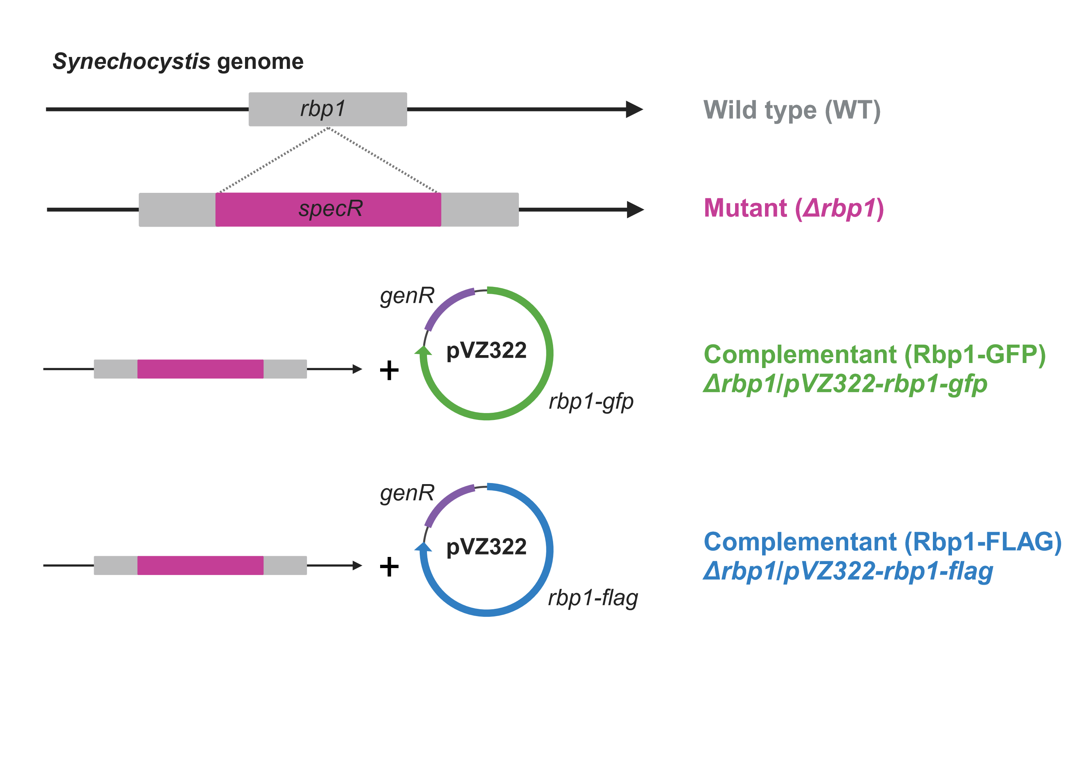
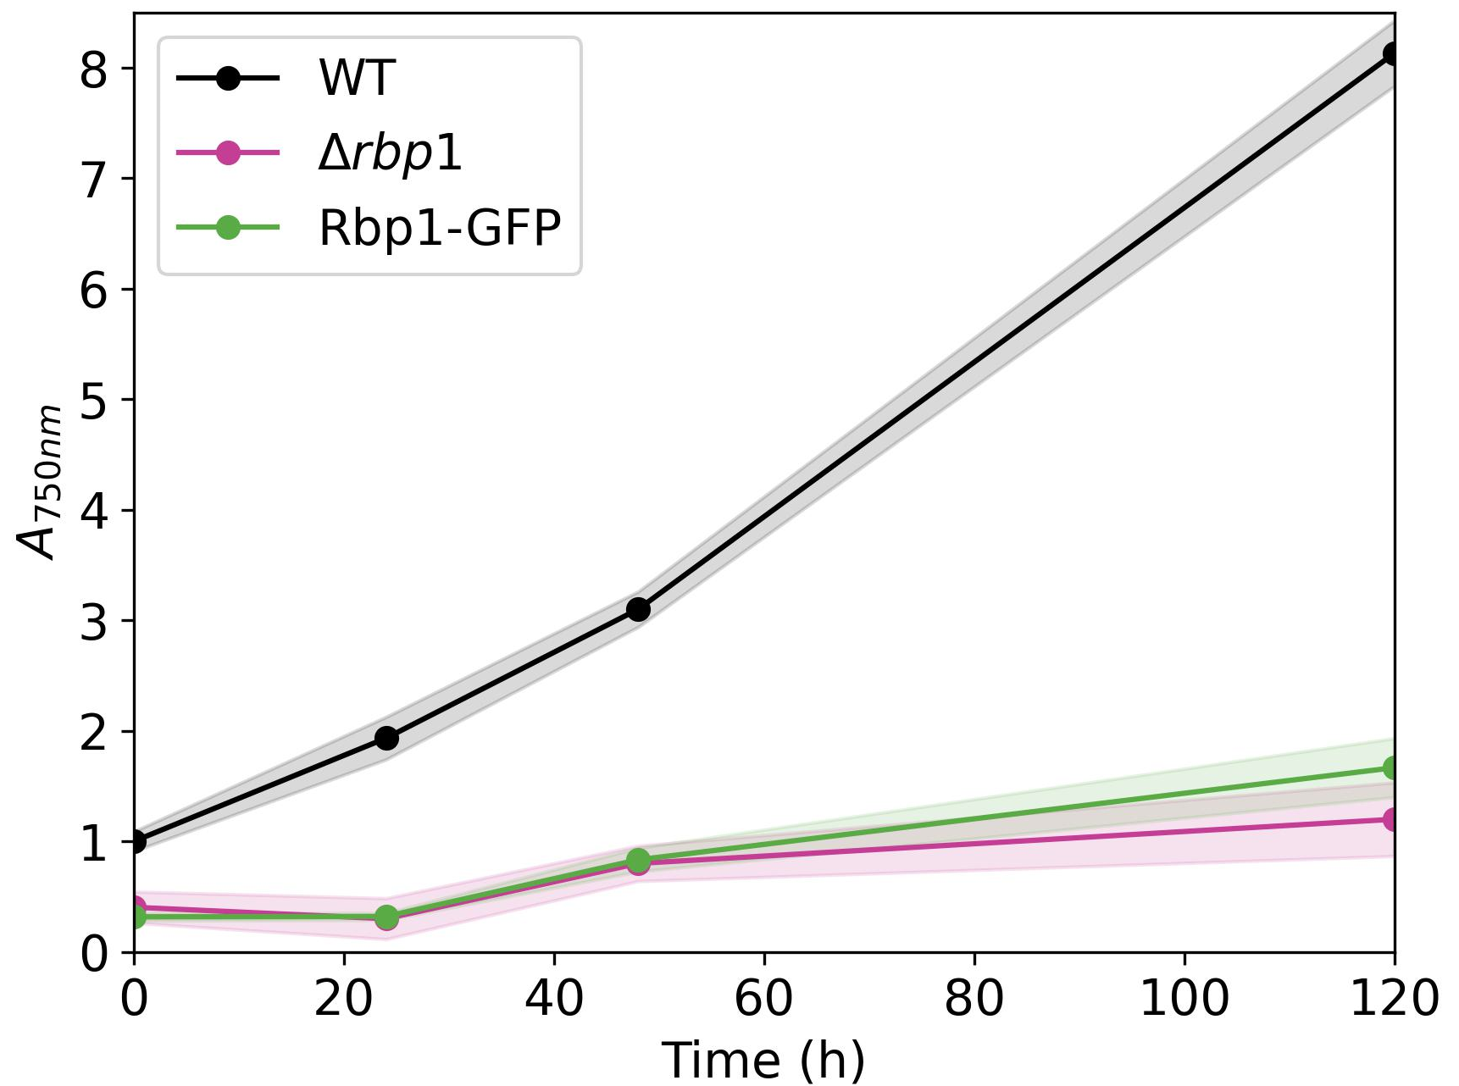
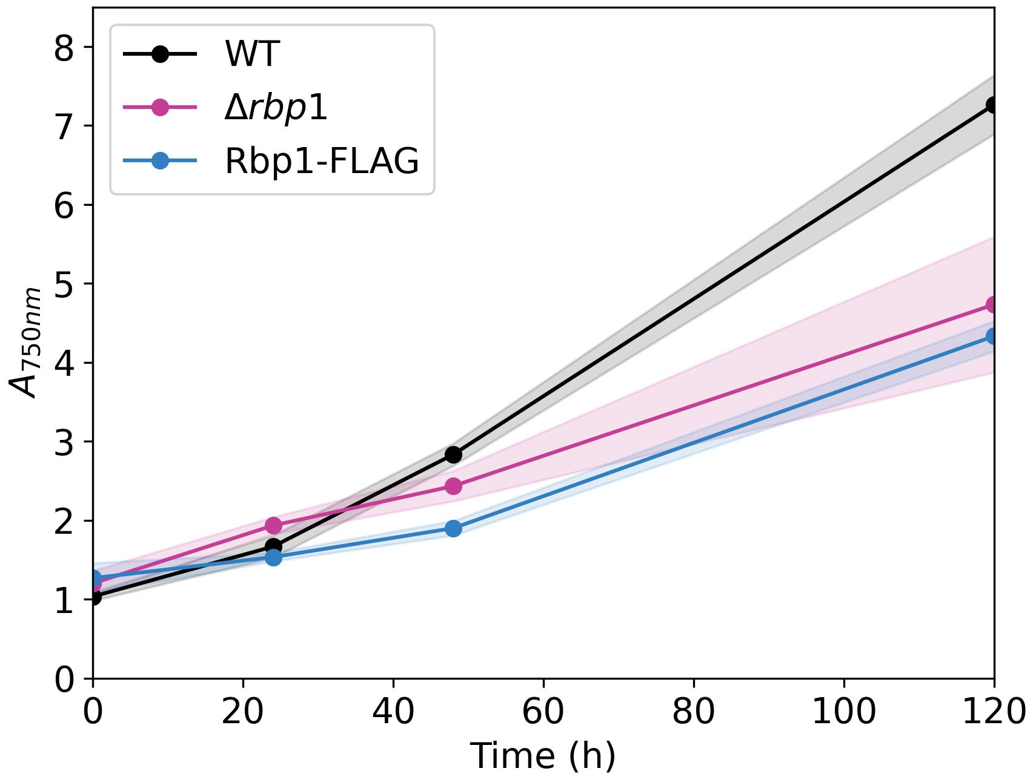
A
B
20 °C
C
20 °C
20 °C
Notes:
Figure 2: Growth of Δrbp1 mutants is impaired at 20 °C, and this phenotype does not seem well complemented by Rbp1-FLAG and Rbp1-GFP constructs.
Synechocystis wild-type (WT) cell growth was compared to that of WT cells with a Δrbp1 locus disrupted by a spectinomycin resistance (specR) cassette (Δrbp1 mutants), and to that of Δrbp1 mutants complemented with a pVZ322 vector bearing a gentamycin resistance (genR) and either a GFP- or a FLAG-tagged Rbp1 (Rbp1-GFP and Rbp1-FLAG complementants, respectively) (A). Growth of Δrbp1 mutants is severely impaired under cold, consistent with the fact that Rbp1 is expressed under cold shock conditions (SOURCE). Growth is not recovered in Rbp1-GFP (B) and Rbp1-FLAG (C) complementants, leading to the hypothesis that the GFP- and FLAG-tags may disrupt Rbp1 function on the long term. All growth curves were obtained by measurement of the absorption at 750 nm before and 24 h, 48 h and 120 h after induction of cold shock.
Image (A) generated using Biorender.com. All constructs used are detailed in ……………. (cite here or only cite in Mat and Met?)

Slide 2
A
B
20 °C
C
20 °C
Notes:
Figure 2: Growth of Δrbp1 mutants is impaired at 20 °C, and this phenotype does not seem well complemented by Rbp1-FLAG and Rbp1-GFP constructs.
Synechocystis wild-type (WT) cell growth was compared to that of WT cells with a Δrbp1 locus disrupted by a spectinomycin resistance (specR) cassette (Δrbp1 mutants), and to that of Δrbp1 mutants complemented with a pVZ322 vector bearing a gentamycin resistance (genR) and either a GFP- or a FLAG-tagged Rbp1 (Rbp1-GFP and Rbp1-FLAG complementants, respectively) (A). Growth of Δrbp1 mutants is severely impaired under cold, consistent with the fact that Rbp1 is expressed under cold shock conditions (SOURCE). Growth is not recovered in Rbp1-GFP (B) and Rbp1-FLAG (C) complementants, leading to the hypothesis that the GFP- and FLAG-tags may disrupt Rbp1 function on the long term. All growth curves were obtained by measurement of the absorption at 750 nm before and 24 h, 48 h and 120 h after induction of cold shock.
Image (A) generated using Biorender.com. All constructs used are detailed in ……………. (cite here or only cite in Mat and Met?)

Slide 3
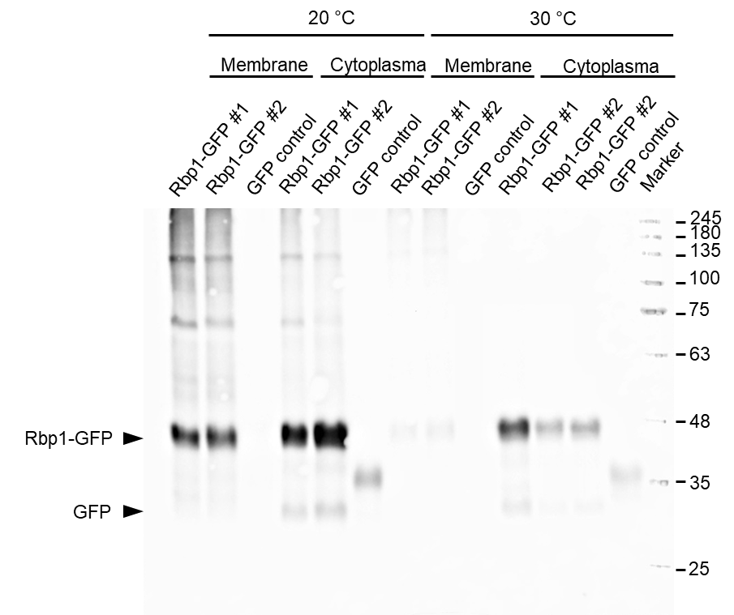
A
B
C
Diskussion: Alternative Bestimmung der Wachstumskurven
Spot assays
Proteinbestimmung
D
20 °C
Notes:
Figure 2: Growth of Δrbp1 mutants is impaired at 20 °C, and this phenotype does not seem well complemented by Rbp1-FLAG and Rbp1-GFP constructs.
Synechocystis wild-type (WT) cell growth was compared to that of WT cells with a Δrbp1 locus disrupted by a spectinomycin resistance (specR) cassette (Δrbp1 mutants), and to that of Δrbp1 mutants complemented with a pVZ322 vector bearing a gentamycin resistance (genR) and either a GFP- or a FLAG-tagged Rbp1 (Rbp1-GFP and Rbp1-FLAG complementants, respectively) (A). The quality of Rbp1-GFP was controlled by anti-GFP Western blot to ensure that GFP is not cleaved off of Rbp1 (B). The quality of Rbp1-FLAG samples was already check similarly by Andreas Schäffler in his Master thesis. Growth of Δrbp1 mutants is severely impaired under cold, consistent with the fact that Rbp1 is expressed under cold shock conditions (SOURCE). Growth is not recovered in Rbp1-GFP (C) and Rbp1-FLAG (D) complementants, leading to the hypothesis that the GFP- and FLAG-tags may disrupt Rbp1 function on the long term. All growth curves were obtained by measurement of the absorption at 750 nm before and 24 h, 48 h and 120 h after induction of cold shock.
Image (A) generated using Biorender.com. All constructs used are detailed in ……………. (cite here or only cite in Mat and Met?)

